Slide 1


Best Practices for Apache Sqoop
By
Karunakar NAIDU

Slide 2
Agenda
Overview of Sqoop
Importing data using Sqoop
Exporting data using Sqoop
Best Practices for Sqoop
Formatting Arguments
Controlling Parallelism
Connectors
Splitting Data
Boundary Queries
Option Files
Using Compression
Batch Exports
ATOMIC EXPORT
Other Effective Sqoop Practices

Slide 3
Overview of Sqoop
Sqoop is a tool designed to transfer data between Hadoop and relational database servers. It is used to import data from relational databases such as MySQL, Oracle etc., to Hadoop HDFS, and export from Hadoop file system to relational databases.
Allows easy integration with Hadoop based Systems:
Hive
HBase
Oozie

Slide 4
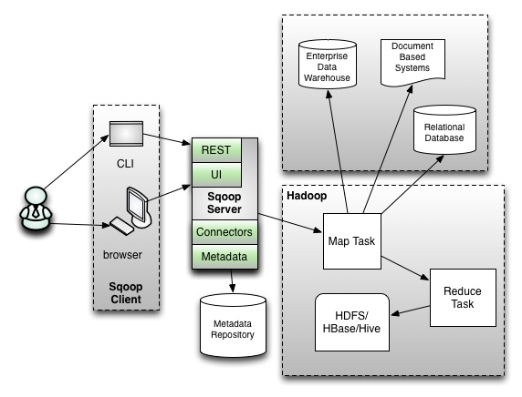
Sqoop Architecture
Client server architecture.
CLI + WEB.
Server access to HIVE and HBASE.
Oozie finds REST API.

Slide 5
Importing data using Sqoop
Ex: Load data from MySQL into Hive
bin/sqoop import
--connect jdbc:mysql://<mysqlhost>:<mysql port>/database \
--username <username>
--password <password>
--table <table name>
--hive-table <Hive table name>
--create-hive-table \
--hive-import \
--hive-home <hive path>
NOTE: Use the command-line parameter --where to specify a SQL condition to import only a subset of data

Slide 6
Exporting data using Sqoop
Ex: Load data from MySQL into Hive
bin/sqoop export \
--connect jdbc:mysql://<mysqlhost>:<mysql port>/database \
--username <username>
--password <password>
--table <table name in mysql or destination table>
--export-dir <the directory in HDFS that contains the source data)>

Slide 7
Formatting Arguments
With imports, use the output line formatting options wherever possible, for accuracy of data transfer - "--enclosed -by", "--fields-terminated-by", "—escaped-by” etc. which helps while processing data with other components in Hadoop eco system.
Formatting Argument | Purpose
enclosed-by | The field enclosing character
escaped-by | The escape character
fields-terminated-by | The field separator character
lines-terminated-by | The end of line char
mysql-delimiters | Default delimiter: fields(,) lines (\n) escaped- by (\) optionally-enclosed-by(‘)
Optionally-enclosed-by | The field enclosing character.

Slide 8
Controlling Parallelism
We can specify the degree of parallel task execution to import data from source database system.
Here increasing parallelism means increasing the number of mappers from default 4 to higher number.
For many database systems and Hadoop clusters, increasing value to 8 or 16 has given a significant performance improvement. But to do so we have to consider many other things, like the no. of mappers slots on Hadoop cluster or spool space of given user etc.
It is recommended to keep lesser map tasks than your cluster map slots if that values increases than the map slots, tasks start execution in serial way which results in degraded performance.
Ex:
sqoop import \
--connect jdbc:mysql://hostname/database_name \
--username user1 \
--password pwd \
--table student \
--m 8

Slide 9
Connectors
Connectors allow Sqoop to transcend SQL dialects while optimizing data transfer. A “connector” is a pluggable piece that fetches metadata about transferred data (columns, associated data types, and so on) to drive data transfer in the most efficient manner. The most basic connector that ships with Sqoop is Generic JDBC Connector, and as the name suggests, it uses only the JDBC interface for accessing metadata and transferring data.
Using direct connectors improves performance.
We can use parameter --direct for connecting directly.
Some of direct connectors are MySQL, PostgreSQL, Oracle, Teradata and others.

Slide 10
Splitting Data
--split-by : It is used to specify the column of the table used to generate splits for imports. This means that it specifies which column will be used to create the split while importing the data into our cluster. It can be used to enhance the import performance by achieving greater parallelism.
Sqoop creates splits based on values in a particular column of the table which is specified by --split-by by the user through the import command. If it is not available, the primary key of the input table is used to create the splits.
Reason to use is sometimes the primary key doesn't have an even distribution of values between the min and max values (which is used to create the splits if --split-by is not available). In such a situation you can specify some other column which has proper distribution of data to create splits for efficient imports.

Slide 11
Boundary Queries
By default sqoop will use query select min(), max() from to find out boundaries for creating splits. In some cases this query is not the most optimal so you can specify any arbitrary query returning two numeric columns using --boundary-query argument.
Reason to use is If --split-by is not giving you the optimal performance you can use this to improve the performance further.

Slide 12
Option Files
When using Sqoop, the command line options that do not change from invocation to invocation can be put in an options file for convenience.
An options file is a text file where each line identifies an option in the order that it appears otherwise on the command line. Option files allow specifying a single option on multiple lines by using the back-slash character at the end of intermediate lines. Also supported are comments within option files that begin with the hash character.
We can specify more than one option files within the same invocation if needed.
Ex: The following Sqoop invocation for import can be specified
alternatively as shown below:
$ sqoop import --connect jdbc:mysql://localhost/db --username foo --table TEST
$ sqoop --options-file /users/homer/work/import.txt --table TEST

Slide 13
Using Compression
Sometimes we would need to keep imported data on HDFS in compressed state in order to reduce the overall disk utilization. As sqoop is based on Map Reduce execution, it inherits Hadoop's all compression features.
It allows us to save imported data into various compressed formats e.g. GZIP or BZ2 etc. We can execute following query to use by default gzip compression.
Ex: sqoop import \
--connect jdbc:mysql://hostname/database_name \
--username user1 \
--password pwd \
--table student \
--compress\
--compression-codec org.apache.hadoop.io.compress.BZip2Codec
This will store all files with .bz2.

Slide 14
Batch Exports
The –batch parameter uses the JDBC batch API.
Enabling batch mode on the JDBC driver queues the queries and deliver batched results.
And also we can set properties :
sqoop.export.records.per.statement (Number of rows that will be
created for single insert statement).
export.statements.per.transaction (Number of insert statements per
single transaction).
Ex : sqoop export -D sqoop.export.records.per.statement=100 --table
<tablename> --export-dir <path>
--input-fields-terminated-by '\t' --input-lines-terminated-by '\n' --connect
'jdbc:netezza://<host>/<db>' --driver org.netezza.Driver
--username <username> --password <passwrd>
--connection-param-file /path/to/sqoop.properties
--batch

Slide 15
ATOMIC EXPORT
We know that in database concepts atomicity means do a complete job or do nothing.
Similarly, if we are exporting data using Sqoop to a table which is very important from the application point of view and you want make sure that sqoop should export all data present in HDFS, then we can use staging-table option. Here, we will mention a staging table where sqoop will export all its data and it all data export is successful then only it should write that data in actual table.
Ex: $ sqoop export \
--connect jdbc:mysql://hostname/database_name \
--username user1 \
--password pwd \
-- export-dir /user/hive/warehouse/student
--staging-table staging_student

Slide 16
Other Effective Sqoop Practices
Do create an empty export table.
Don’t use the same table for both import and export.
Do use --escaped-by option during import and --input-escaped-by during export.
Do use fields-terminated-by during import and input-fields-terminated-by during export.
Don’t specify the query, if you use the direct connector.

Slide 17
Other Effective Sqoop Practices
Use the verbose argument (--verbose) for more information during trouble-shooting.
Be cognizant of the configuration of concurrent connections allowed to the database; Use fetch size for controlling number of records to be read from the database, and also factor in the number of parallel tasks.
Be aware of case sensitivity of Sqoop.

Slide 18


